Slide 1
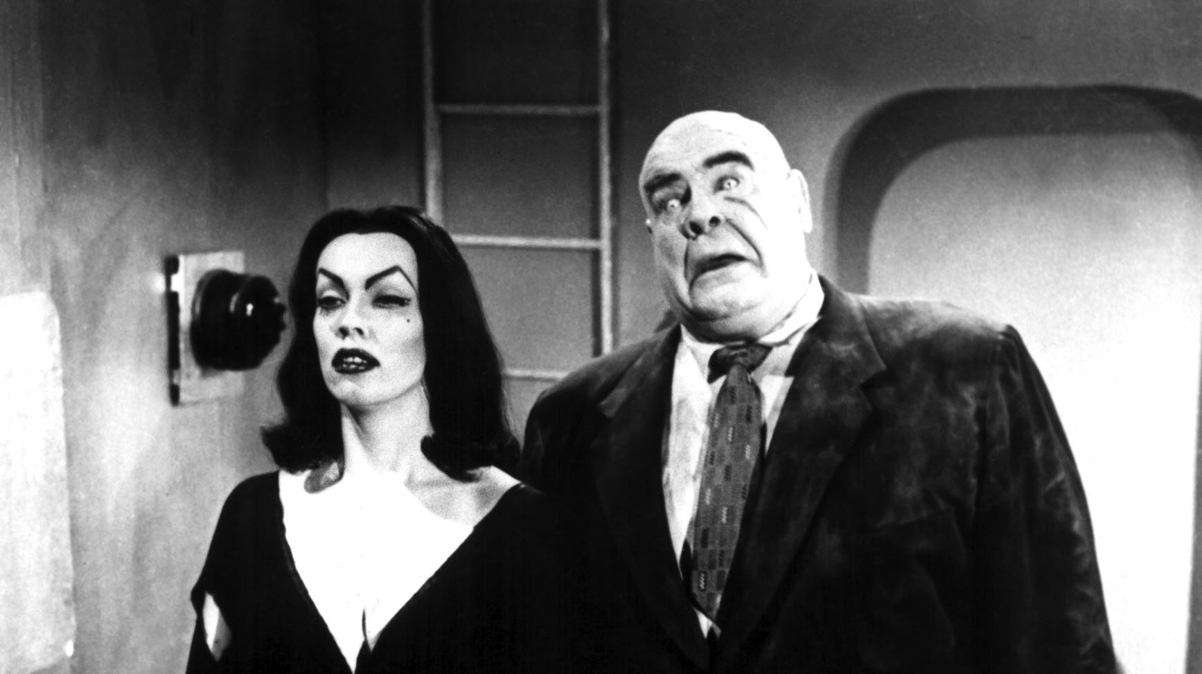
Trees and Tries
Prof. Darrell Long
CSE 13s

Slide 2
What’s a tree?
Quite simply, a nonlinear data structure, consisting of either zero nodes or one node (known as the root), recursively containing zero or more subtrees.
Learn more at r/trees
Terms to know:
Root
Parent
Child
Leaf
Subtree
Traversal
Successor
Predecessor

Slide 3
Binary tree
A modification to the generic tree data structure such that each node can have at most 2 children
All binary trees are composed of zero (empty tree) or more nodes where each node contains:
Some form of data
A reference to a left child (Default to NULL)
A reference to a right child (Default to NULL)
If a node has no children, it is known as a leaf node
Notes:
[NOTE] Will remove photo at a later time because of Title 9

Slide 4
Types of Binary trees
Full Tree Vs Complete Tree
Five different types:
Full Binary Tree
Every node other than the leaves has 2 children
Complete Binary Tree
Every level, except possibly the last, is completely filled,
Skewed Binary Tree
All nodes in the tree have either one or no children
Extended Binary Tree
Replace all null pointers with external nodes
Balanced Binary Tree
Any node’s right subtree and left subtree differ by no more than 1
Skewed Tree
Balanced Binary Tree

Slide 5
Binary Search tree
Special binary tree with the following properties:
Left subtree of a node contains nodes with a value less than the node’s value
Right subtree of a node contains nodes with a greater value than the node’s value
Left and right subtree must also be a binary search tree
Common Operations:
Find
Insert
Delete
Notes:
Full Binary Tree
Every node other than the leaves has two children.
Complete Binary Tree
Every level, except possibly the last, is completely filled, and all nodes are as far left as possible.
Skewed Binary Tree
All nodes have either one child or no child
Extended Binary Tree
Basically a binary tree where external nodes are added. Replace all the null pointers with external nodes (Turns it into a complete binary tree)
Balanced Binary Tree
Left and right subtrees of every node differ in height by no more than 1

Slide 6
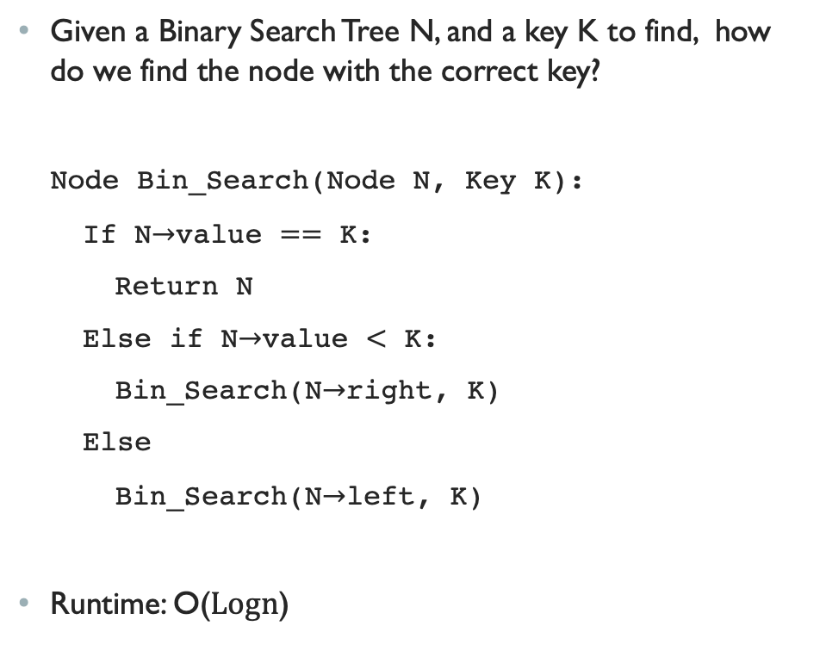
find
Given a Binary Search Tree N, and a key K to find, how do we find the node with the correct key?
Node Bin_Search(Node N, Key K):
If N$→$value $==$ K:
Return N
Else if N$→$value $<$ K:
Bin_Search(N$→$right, K)
Else
Bin_Search(N$→$left, K)
Runtime: O($\text{Logn}$)
Notes:
GIF from www.mathwarehouse.com

Slide 7
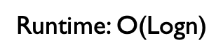
Insert
Note: always insert at the leaf nodes
Node insert(Node N, Key K):
If N->NULL:
CreateNode(K)
If(N->value < K):
Insert(N->right, K)
Else if(N->value > K):
Insert(N->Left, K)
Runtime: O($\text{Logn}$)
Notes:
GIF from www.mathwarehouse.com

Slide 8
delete
Perhaps the most difficult operation
If the node to be deleted is a leaf, simply remove from the tree
If the node to be deleted has one child, then the child will replace it
If the node to be deleted has two children, then use the in-order successor (right subtree’s left most node) or the in-order predecessor (left subtree’s right most node)

Slide 9
Traversal order
What’s a traversal?
Quite simply, the process of visiting each node in a tree
Three different kinds of traversals, based off of visiting order
Preorder Traversal:
Useful for prefixes (Ex. Polish Notation +ab)
Inorder Traversal:
Useful for traversing elements in sorted order
Postorder Traversal:
Useful for processing subtrees before root (Ex. Reverse Polish Notation)
Notes:
Preorder: I L R
Inorder: L I R
PostOrder: L R I

Slide 10
tries
Also referred to as a digital search tree, similar to a tree data structure
An ordered tree data structure
Similar to a tree data structure, but nodes store the entire alphabet
Words are retrieved/found by traversing down a branch
Notes:
Referred to as digital search tree
Similar to tree data structure
talk about what it is, definition of a trie
Ordered tree data structure
Each node stores the entire alphabet that we’re using (26 if English alphabet, 256 for ascii) <- @tim, double check this para mi
All descendants/children of a node have a common prefix, we can add a picture to this slide that is an example of this, shore VS. shell
Think of it as looking up a word in a dictionary, analogy here!!! Nail that understanding into the kiddies
Applications/uses
Searching, retrieving
Autocomplete dictionary
Insert/search is O(word length)

